Slide 1

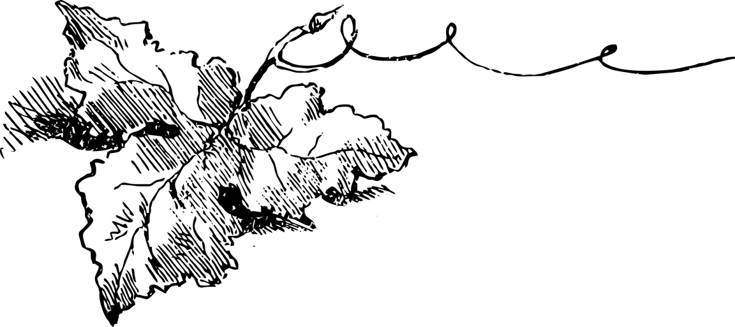



UT Data Analysis and Visualization Bootcamp
Project 4, Group 7
WineInsight: Predicting Ratings & Recommending Wines for Beginners
Lakshmi Adithya, Alyssandra Calhoun, Bianca Torres, Sabrina Martin, Jose Moncada

Slide 2


Welcome To OUR Presentation
We are excited to share our project with you!
Presented for the UT Data Analysis and Visualization Bootcamp
Project 4, Group 7
Team Members: Lakshmi Abbaraju, Alyssandra Calhoun, Bianca Torres, Sabrina Martin, Jose Moncada.
Let us take you through our insights — sip by sip!.

Slide 3

01
Project Overview

Slide 4
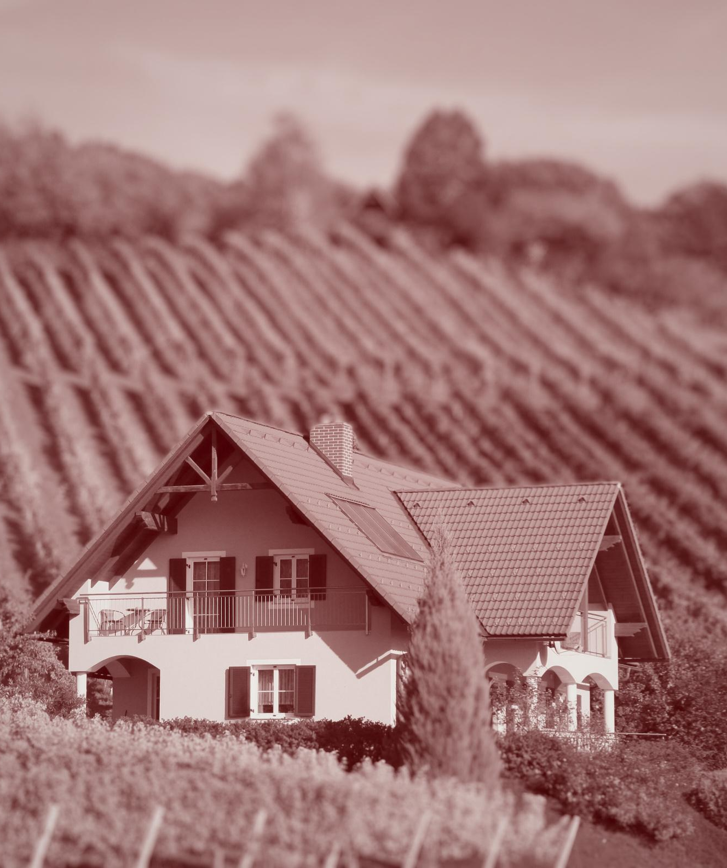

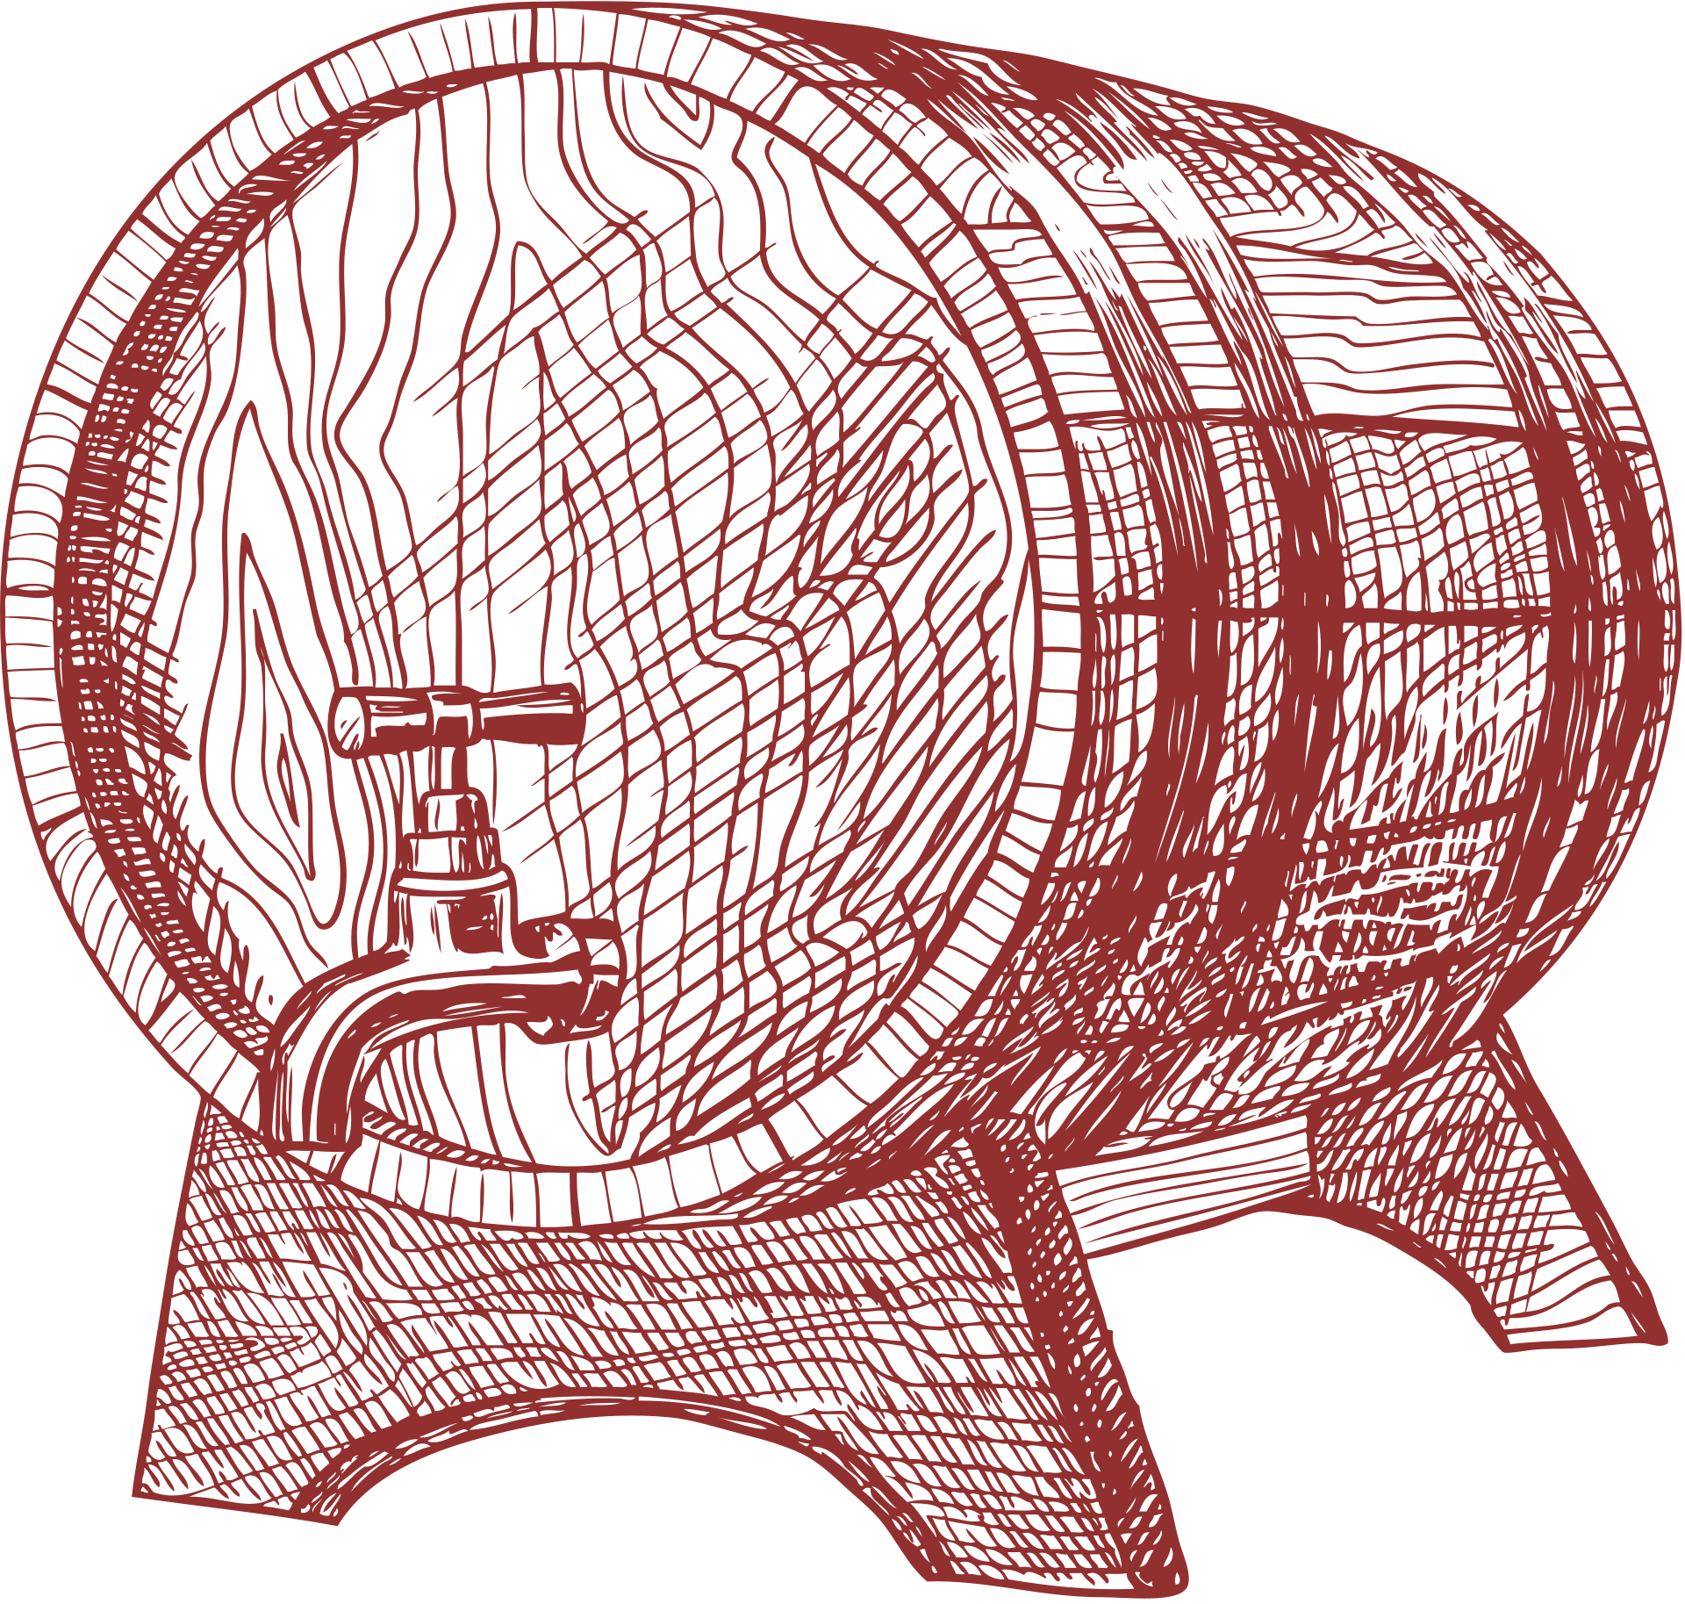
Objective
Analyze wine data to predict ratings and recommend beginner-friendly wines.
Use machine learning to uncover patterns and enhance the wine selection experience.
Motivation
Simplify wine choices for enthusiasts.
Leverage data insights to guide wine preferences.

Slide 5
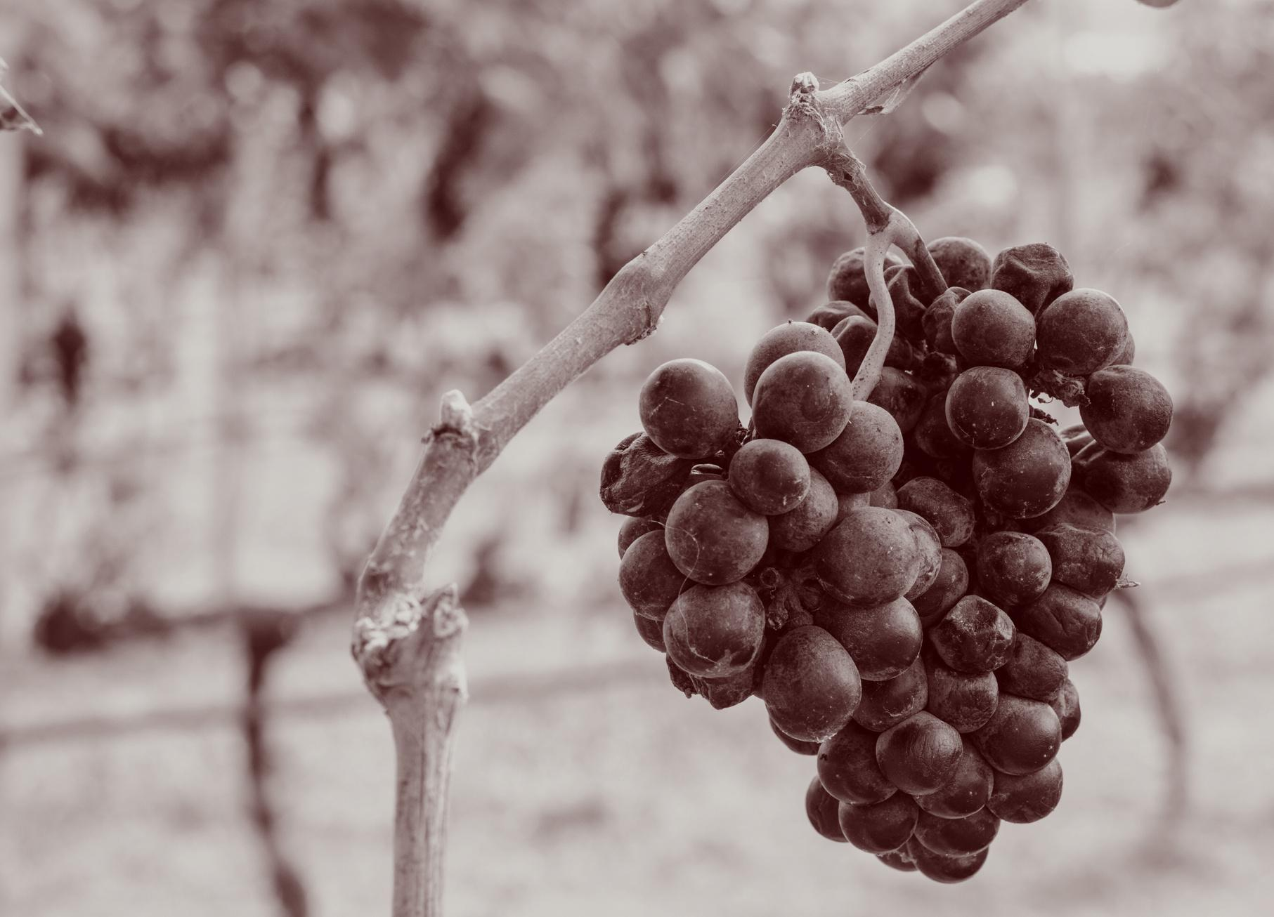
02
Goals

Slide 6





Goals
Data Cleaning & Transformation
Exploratory Data Analysis (EDA)
Predictive
Modeling
Recommendation System
Handle missing values.
Extract key features (e.g., vintage year).
Categorize ratings and wine styles.
Visualize rating distribution, price trends, and variety patterns
Use machine learning to forecast wine ratings.
Suggest wines based on beginner preferences.

Slide 7

03
Data Cleaning & Transformation

Slide 8

Dataset Overview
Source: winemag-data-130k-v2.csv
From Kaggle: Wine Reviews Dataset
Size: ~130,000 entries
Key Features:
Country, Province, Region
Wine Variety, Winery, Taster Name
Points (Rating), Price
Wine Title (includes year and descriptions)
Data Cleaning & Transformation
Handling Missing Values:
Fill or drop null entries for key features.
Feature Engineering:
Extract vintage year from wine titles.
Categorize points into quality labels (e.g., excellent, good, average).
Classify wines into styles (red, white, rosé).
Data Export:
Save cleaned dataset as winemag-data-clean.csv

Slide 9
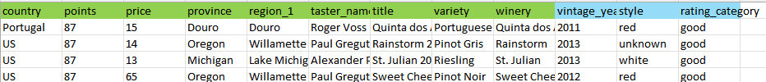
Before
Original CSV: winemag-data-130k-v2.csv
After
Clean CSV: winemag-data-clean.csv
We processed the raw dataset and introduced three new features:
Extracted the year from the title column.
Determined a red or white classification using details from the variety, description, and title columns.
Categorized ratings into five groups: below average, average, good, very good, and excellent.

Slide 10
04
Machine learning

Slide 11
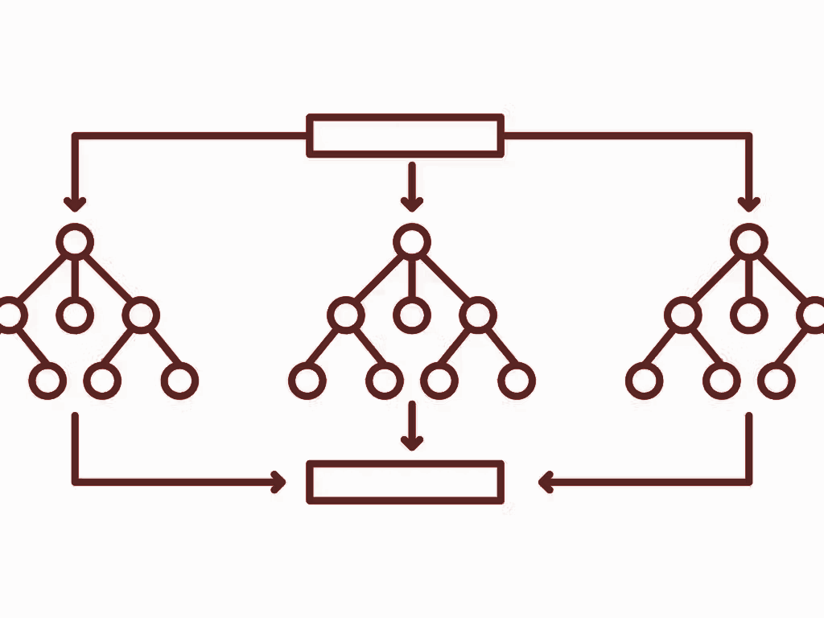

Machine learning model
Random Forest Classifier
Random Forest Classifier model chosen to predict classifications in this large dataset.
We decided to use 250 decision trees in this model

Slide 12





The process
Clean Dataframe
OneHotEncoder
Fit Model
Profit
Import dataframe
Convert ‘country’, ‘region’, ‘variety’, ‘style’ and ‘rating_category’ columns to binary values.
Train model on ‘rating_category_good’ column
Create and display confusion matrix
View value counts and info
Use sklearn to calculate feature importances
Analyze the results and accuracy score
Drop ‘unknown’ values and ‘title’ & ‘winery’ columns
Data Frame is now ready for machine learning!
Use model to predict points_category_excellent’ column
Go out and buy an ‘excellent’ bottle of wine

Slide 13
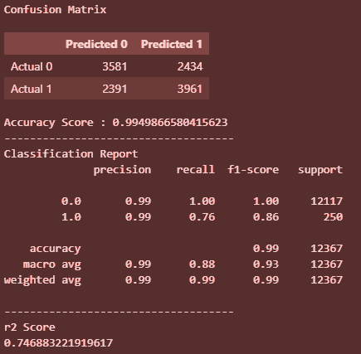
results
Importances
Top 3 most important features:
Price (28%)
Vintage Year (19%)
Points (19%)
The Confusion Matrix
The model scored 99% accuracy to predict the qualities that mark an ‘rating_category_excellent’ wine
Worth noting is the model’s ability to predict the true negative with a 76%
…

Slide 14
05
Visualizations

Slide 15
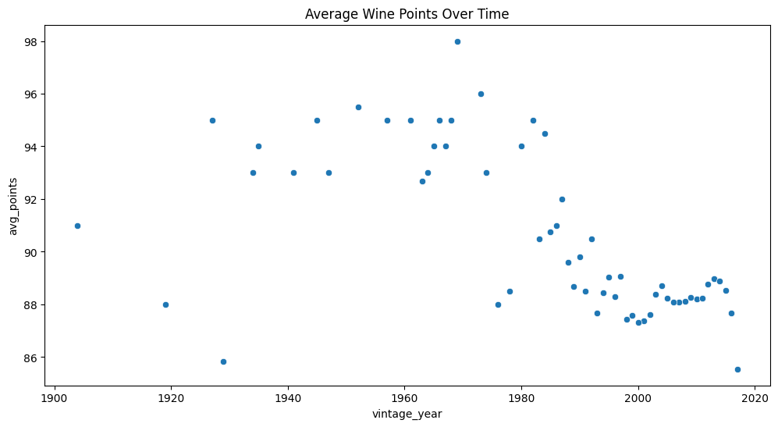

Notes:
During my EDA, i generated this graph to demonstrates if there is a trend between vintage year and avg points.

Slide 16
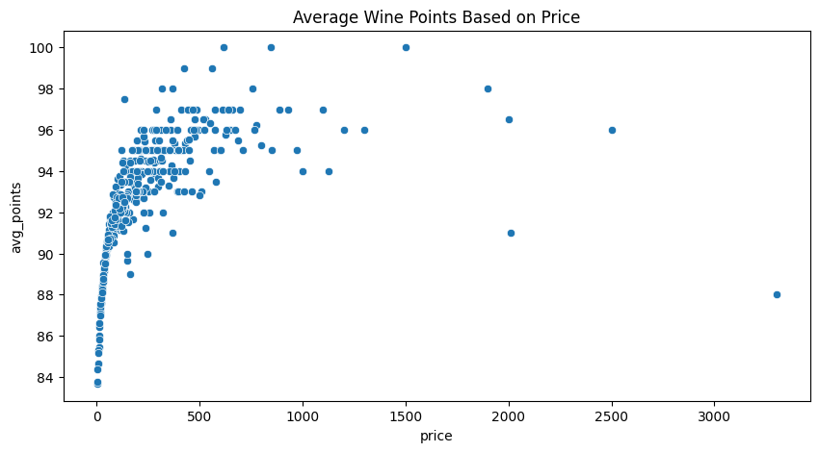

Notes:
this graph demonstrates the trend between price and avg wine points. Wine that is semi cheap or semi expensive tend to score higher points
From using EDA it help my group better understand what features should stay and go to help our machine model run as efficiently as possible with good results.

Slide 17
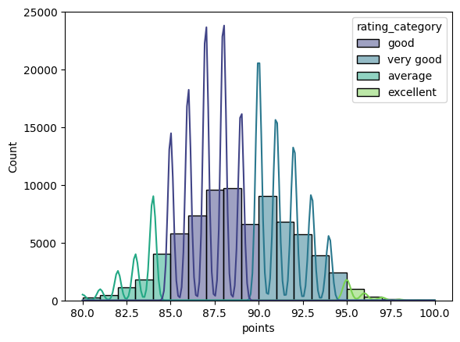
Notes:
this graph demonstrates the trend between price and avg wine points. Wine that is semi cheap or semi expensive tend to score higher points
From using EDA it help my group better understand what features should stay and go to help our machine model run as efficiently as possible with good results.

Slide 18
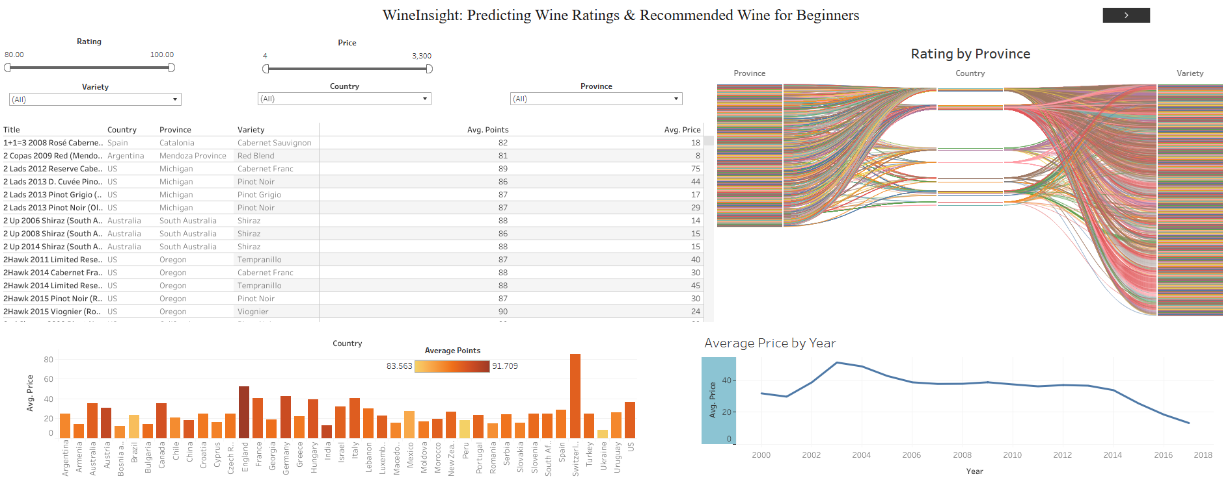
Tableau - DashBoard

Slide 19
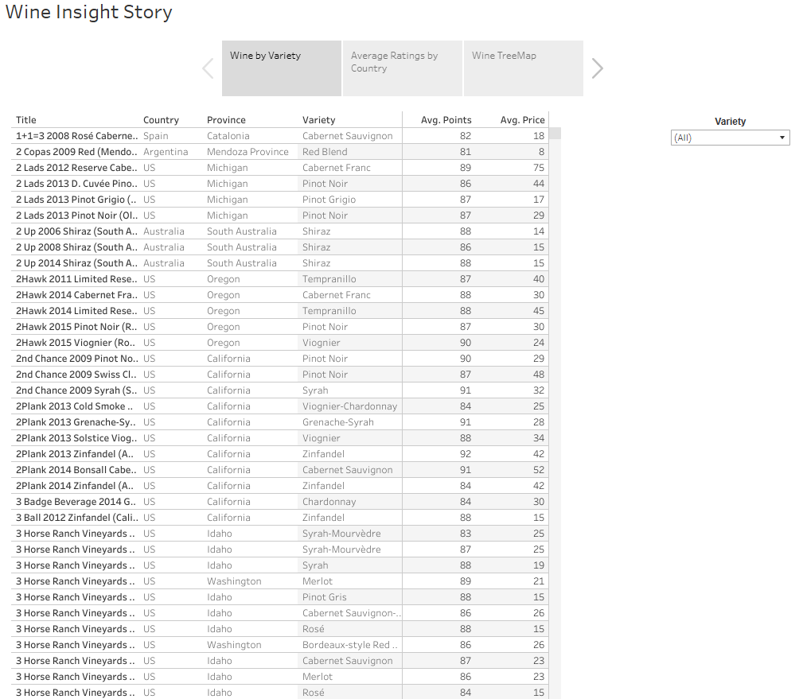
Tableau - Story

